Slide 1

Analyse marketing data for call campaign by Bank
Tran Trung Kien
Ly Tu Long
Nguyen Van Dung

Slide 2
PROBLEM
Our client―a Portuguese banking institution—ran a marketing campaign to convince potential customers to invest in bank term deposit. Information related to direct marketing campaigns of the bank are as follows. The marketing campaigns were based on phone calls. Often, the same customer was contacted more than once through phone, in order to assess if they would want to subscribe to the bank term deposit or not.

Slide 3
REASONS TO USE SPARK SQL
Spark SQL makes use of real-time data and has a better engine that does the fast computation.
Very faster 100 times than Hadoop . It uses an RPC server to expose API to other languages, so It can support a lot of other programming languages.
PySpark is one such API to support Python while working in Spark.

Slide 4
HOW DOES IT WORK?

Slide 5
QUESTION:
1/A. Give marketing success rate. (No. of people subscribed / total no. of entries)
B. Give marketing failure rate
2/Maximum, Mean, and Minimum age of average targeted customer
3/Check quality of customers by checking average balance, median balance of customers
4/Check if age matters in marketing subscription for deposit
5/Check if marital status mattered for subscription to deposit.
6/ Check if age and marital status together mattered for subscription to deposit scheme

Slide 6
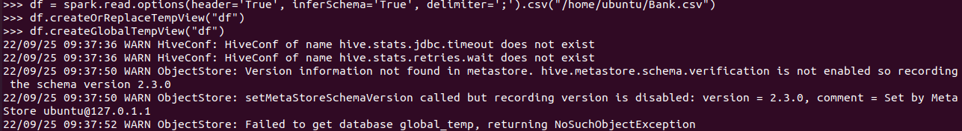
Query 1 :Load data and create Spark data frame
df = spark.read.options(header='True', inferSchema='True', delimiter=';').csv("/home/ubuntu/datasets/Bank.txt")
df.createOrReplaceTempView("df")
df.createGlobalTempView("df")

Slide 7

Query 2 :A. Give marketing success rate. (No. of people subscribed / total no. of entries) B. Give marketing failure rate
q2a = df.filter(df.y=='yes').count()/df.count()*100
q2b = df.filter(df.y=='no').count()/df.count()*100
Notes:
Collumn y stand for people subcribe or not and the success rate is number of people is subcribe per total
And failure rate is similar but y is no

Slide 8
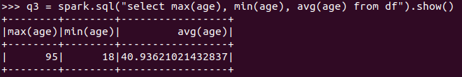
Query 3 :Maximum, Mean, and Minimum age of average targeted customer

Slide 9
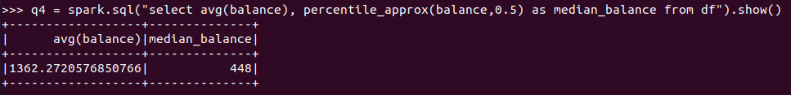
Query 4 :Check quality of customers by checking average balance, median balance of customers

Slide 10
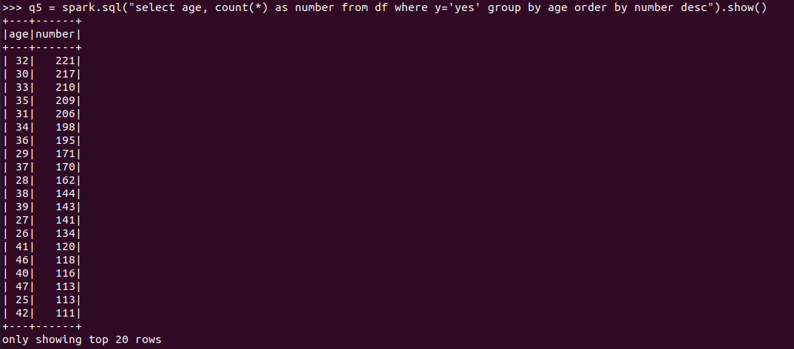
Query 5 :Check if age matters in marketing subscription for deposit
Notes:
Gần độ tuổi 32 thì mn đăng kí nhiều nhất và càng xa tuổi 32 thì càng ít người đăng kí

Slide 11
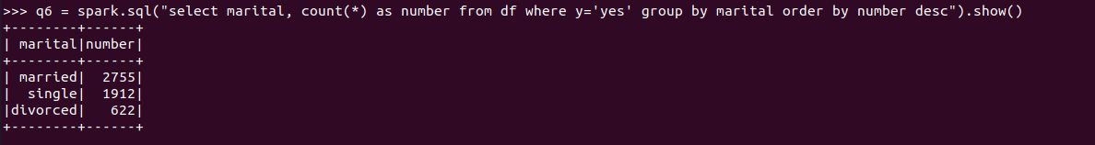
Query 6 :Check if marital status mattered for subscription to deposit.
Notes:
Rút ra kết luận : nên quảng bá cho những cặp đôi

Slide 12
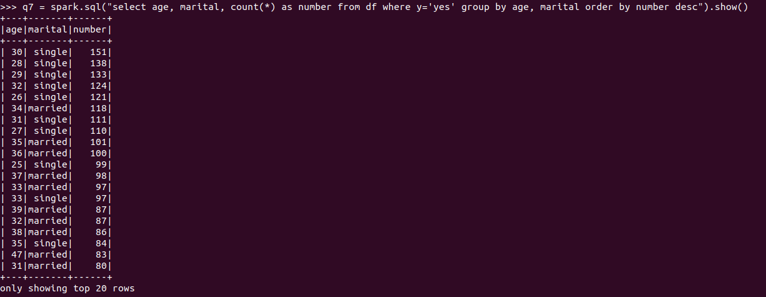
Query 7 :Check if age and marital status together mattered for subscription to deposit scheme

Slide 13
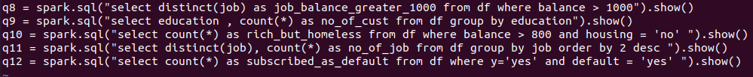
Extra query:

Slide 14

Thank You

